Slide 1
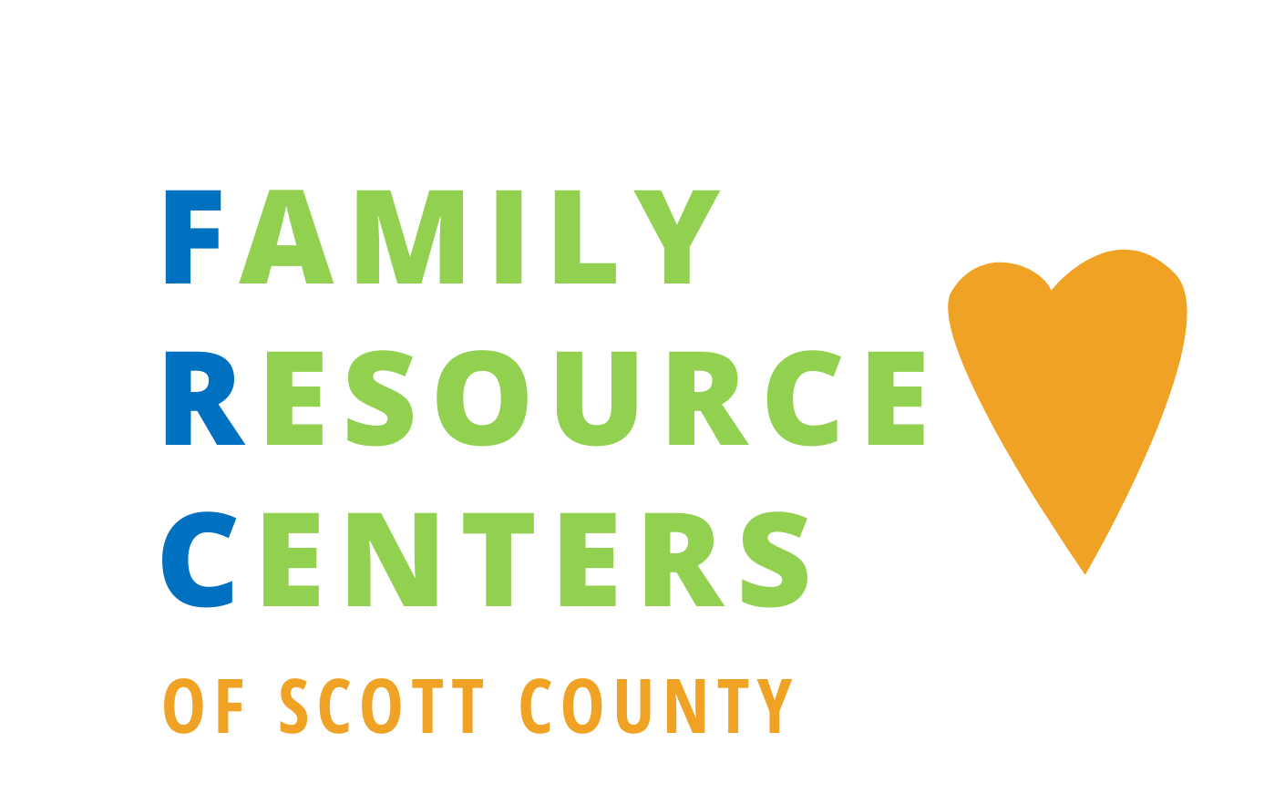

Slide 2
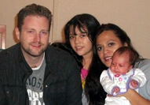
ABOUT FAMILY RESOURCE CENTERS (FRCs)
Provide a safe, accessible places for families to connect with coordinated services that help families achieve their goals. Programs at each center are tailored to the culture, resources, and needs of the community they serve and focus on building on the strengths of each individual, family and community.
Grow community engagement and support community-developed solutions. Use a community based, whole family approach so families have what they need to thrive. This will look and feel different in every community.
Programming is flexible and can adapt to the changing needs of families and communities
This Photo by Unknown Author is licensed under CC BY-NC-ND
Notes:
Increase service array and accessibility to services will decrease need for and or reliance on deep-end services. We have consistently heard from families the frustration around the need to make “one more stop” to address their needs. This builds on the premise of a “one stop shop”.
Transforming how we deliver services and enable communities to have greater input into what services are needed.
FRCs not only provide programs but build communities of peer support for families where caregivers develop social connections that reduce isolation
and stress, which are highly correlated with child abuse.
Make it easier for families to get what they need. Develop universal access points for families that provide a navigation of programs and systems that are culturally appropriate, relationship-based
Increase access to services.
Provide a safe, accessible places for families to connect with coordinated services that help families achieve their goals. Programs at each center are tailored to the culture, resources, and needs of the community they serve and focus on building on the strengths of each family, individual, and community.
Grow community engagement and support community-developed solutions. Use a community based, whole family approach so families have what they need to thrive. This will look and feel different in every community
Programming is flexible and can adapt to the changing needs of families and communities

Slide 3
Why Family Resource Centers?
FRCs:
Promote the strengthening of families through formal and informal support and the restoration of a strong sense of community. (Child Welfare Information Gateway)
Reduce child abuse and neglect/reduce trauma (ACES)
Reduce out of home placement
Increase (by 20 percent )in parents’ self-reports on their ability to keep the children in their care safe from abuse in Massachusetts.
Provide mandated reporters an alternative resource to call when there may be concerns about a child family (Reframe mandated reporters to mandated supporters)
Reduce disparities in our system
Casey Family Programs, “Do place-based programs, such as Family Resource Centers, reduce risk of child maltreatment and entry into foster care?”, Supportive Communities Issues Brief, June 2019)
Notes:
A 45 percent reduction in cases of child abuse and neglect in Alachua (Alacha) County, Fla.
Significantly lower rates of child maltreatment investigations in communities with FRCs in Allegheny County, Pa.
A Social Return on Investment Study in Alabama determined that for every $1 invested in FRCs, the state received $4.93 in immediate
and long-term consequential financial benefits.
A 2018 evaluation report conducted for the Allegheny County Department of Human Services (Pennsylvania) by the University of Chicago’s Chapin Hall Center for Children determined that neighborhoods with Family Support Centers had significantly lower rates of child abuse and neglect investigations than similar neighborhoods without them (30.5 investigations per 1,000 children versus 41.5 per 1,000 children).
The FRCs partner with families to support them by taking an active role in the development of the center, including soliciting their input to shape and plan programs, developing their skills to co-facilitate activities, leveraging their help with outreach: PARENT LEADERSHIP

Slide 4
FRC Intent and Plan
Leverage
Leverage existing county and community resources to meet the multi-faceted need of children and families.
Target
Target outreach and services to support expectant families, families with very young children, families experiencing homelessness, and any family needing support.
Provide
Provide access community access points to these services, and navigation across them.
A network of services, providers, programming and training to support child and family stability and community wellbeing
Notes:
We intend to pilot community hubs in three locations across Scott County: 1) the Shakopee Library; 2) the River Valley YMCA; and 3) the Jordan Food shelf. Each site would strengthen their current service array by complementing and customizing new resources to support the complex needs of the families they serve, with a focus on and outreach to expecting and parenting families of very young children and those experiencing homelessness and housing insecurity. With a coordinator employed by Scott County, we will be able to build co-location practices for our safety-net and prevention services, and access county data to inform impact and direct programming and outreach efforts. These County attributes, alongside the expertise and experience of our partners provides a unique opportunity to meet the needs of the community alongside the community.
These pilot community hubs will utilize a “one-stop-shop” model, ensuring families do not experience a “one-more-stop” reality. We are eager to web-based navigation at our three pilot sites and across our Scott County Libraries, and will partner to provide cultural navigation for East African and Latix families. The Mental Health Center, is eager to provide early childhood mental health and development training and consultation to staff and families alike.

Slide 5
FRC Mission/Vision
MISSION:
To promote positive outcomes for all Scott County children, families, and communities by advancing quality family supports through family-centered practices and policies and leveraging partnerships with public, private, non-profit, business and faith communities to promote healthy child development and family resiliency.
Vision:
A community in which community partners, collaborators and individuals come together to help families and children thrive.

Slide 6
Built on 5 Protective Factors
Parental Resilience
Ability cope and bounce back
Social Connections
From people who can provide emotional support and concrete assistance
Knowledge of Parenting and Child Development
Adequate information about raising young children and expectations for their behavior and needs
Concrete Support in Times of Need
Access to basic needs –health care, mental health care, informal supports
Children’s Social and Emotional Development
Ability to interact positively with others and communicate emotions effectively

Slide 7
Schedule and Locations
Opened
August 2021!
Shakopee Library
Mondays: 3-7pm
Jordan Food Shelf
Wednesdays: 4-7pm
YMCA @ River Valley
Thursdays: 2-6pm
 | Themes
Week 1 | Parenting and Family Supports
Week 2 | Health and Wellness
Week 3 | Education and Early Literacy
Week 4 | Community Support

Slide 8
At the FRCs, you will find:
Parenting skills, support, and mentorship programs
Early literacy and education programs
Health and wellness services and programs
Financial literacy classes
Economic Assistance, Housing and Legal Navigation Services
Domestic Violence Education and Advocacy
Peer Recovery Support Services
Culturally specific service navigation and language access for Latinx and Somali communities

Slide 9
FAMILY RESOURCE CENTER PARTNERS
Beacon Interfaith Housing Coalition
CAP Agency - Parents Helping Parents
CAP AGENCY:
Esperanza
Isuroon
Jordan Area Food Shelf
MN Teen Challenge
NAMI
River Valley Health Services
Safe Families for Children
Scott County Economic Assistance Navigation
Scott County Housing Consultation
Scott County Libraries
Scott County Parks
Scott County Public Health
Scott County Mental Health
Scott County Law Library
Shakopee Library
SMRLS
Southern Valley Alliance
St. Francis Regional Medical Center/Allina
The Forgotten Initiative - Scott County Circles
U of M Extension
YMCA @
River Valley
Notes:
This is a growing list of on-site partners and contributors.

Slide 10
Notes:
Normalize help seeking, reduce stigma

Slide 11
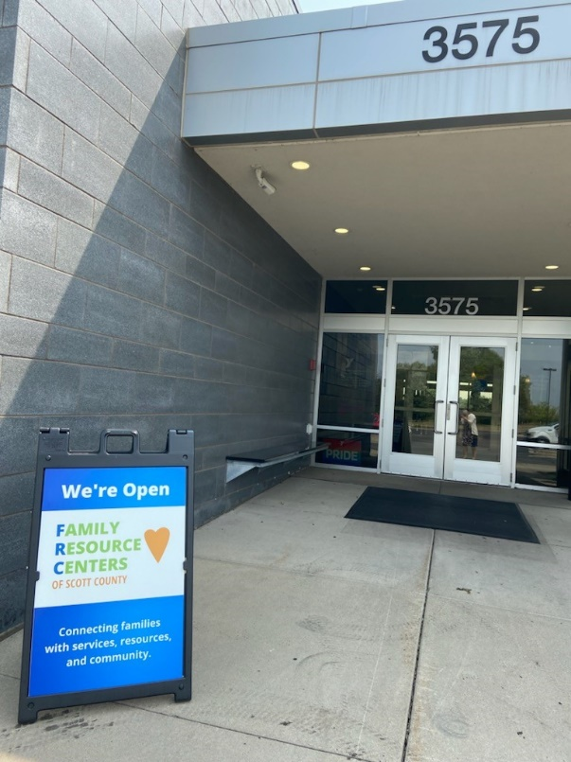
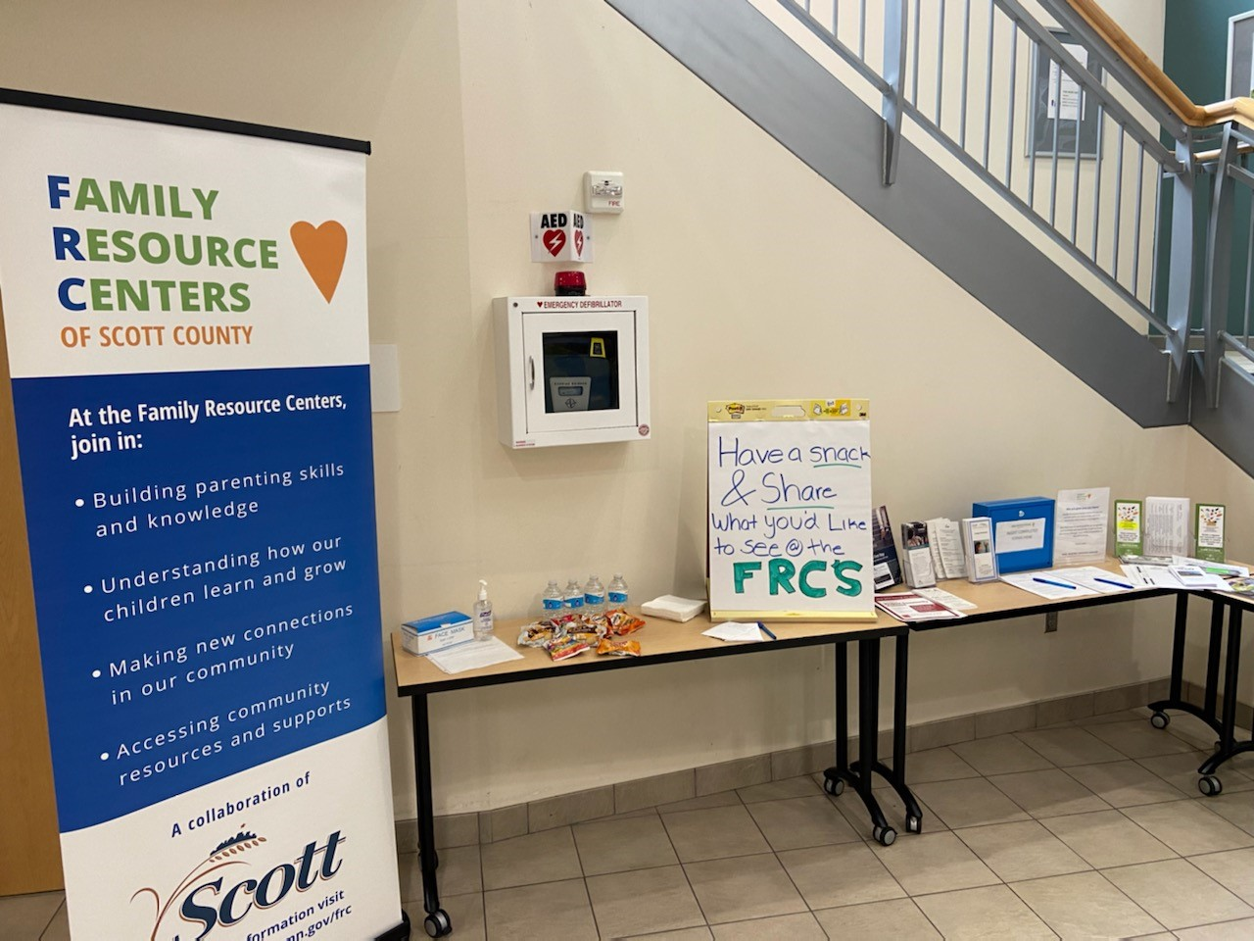

Slide 12
Engagement and Outreach
August 2021-to date
Adults/Children Engaged: 100+
Referral Forms Completed: 9
Outreach
Emails and engagement across Scott County HHS,
Emails to community partners, law enforcement, city officials, school districts, etc.
Social Media –Scott County, Scott County Library, community partners
Printed flyers distributed through CAP backpack program and posted in schools/community locations.
Direct outreach through community events and presentations: Examples: Tabling at the Scott County Fair and Back-to-School events. SCALE, Scott County Resource Council and Scott Family Net presentations.

Slide 13
CONTACT INFORMATION
FRC Website: www.scottcountymn.gov/frc
Krystal Boyechko, FRC Coordinator
Email: kboyechko@co.scott.mn.us
Phone: 952-270-9983
Suzanne Arntson, Social Service Manager
Email: sarntson@co.scott.mn.us
Phone: 952-496-8212

Slide 14
Thank you!
Questions?

